Slide 1
CAS Python Workshop: Session 2 Pandas
Stephen Mildenhall & Brian Fanin
July 22, 2020

Slide 2
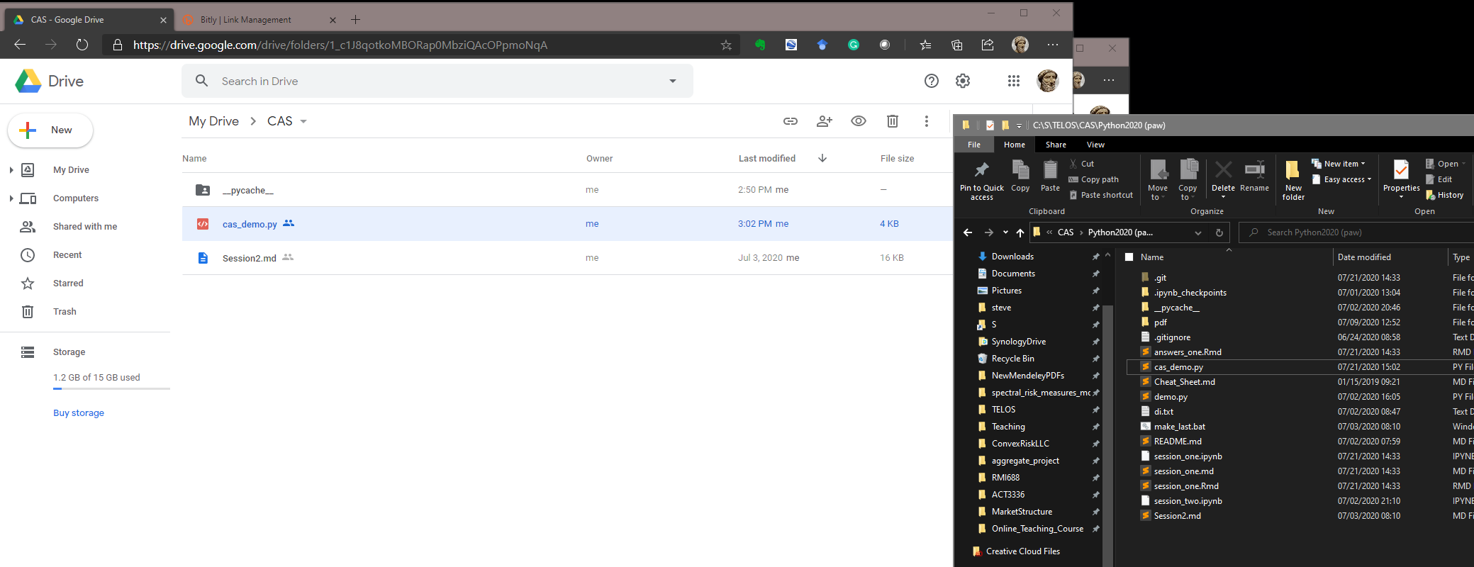




Copy files from https://bit.ly/2ZQdgh0 to your Google Drive Upload and Download

Slide 3
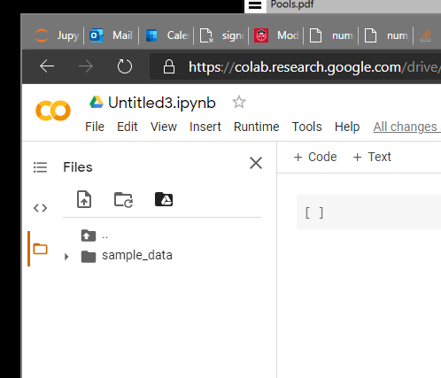
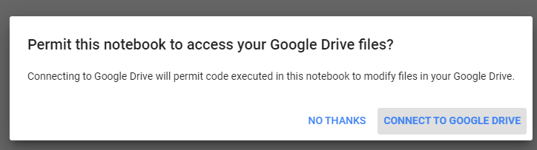
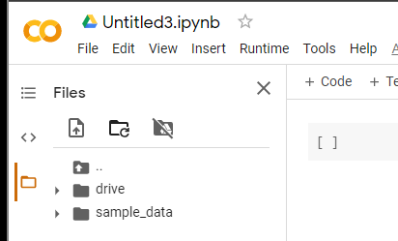











Enable Access to Google Drive from Colab

Slide 4
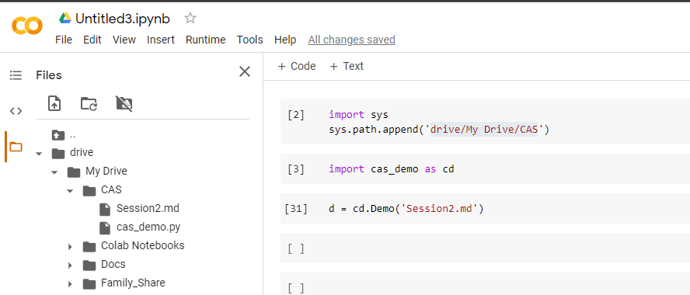










Start New Colab Notebook; Copy Code Below...
Select directory from your Google Drive

